Slide 1
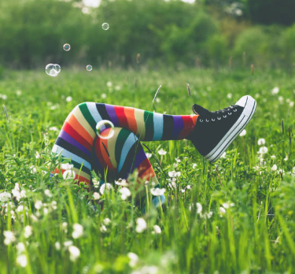
Session 7
What is normal anyway?

Slide 2
Welcome to Session 7. You know by now that Matt and Gemma are helping us through these sessions.
In Session 6, we learned about the power of bouncing back and that it is sometimes hard but a very necessary thing to be able to do.
We looked at how we handle ourselves when things go wrong and how we can overcome challenges.

Slide 3
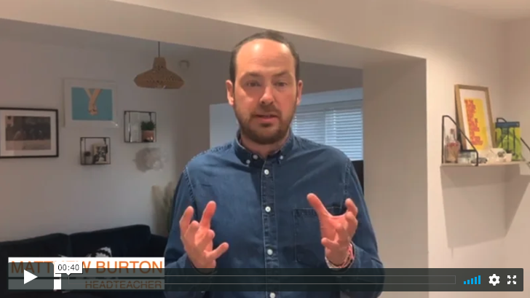
Today we are looking at ‘what is normal anyway?’ Here is Matthew to explain some more…
Gemma will be back at the end of the session as usual!
Read from page 63 to page 83, if you have a copy of ‘Go Big’.

Slide 4
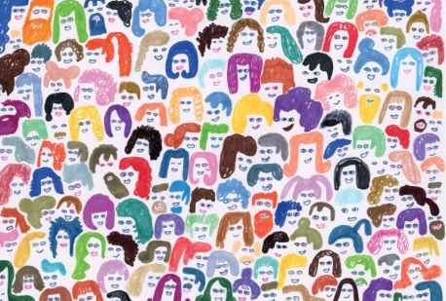
Do you ever wonder what normal is?
Is it the way someone acts?
The way someone dresses?
What people say?
How smart they seem?
Who they hang around with?
What they want to become?

Slide 5
It can be easy to wish you were more ‘normal’ – whatever that means!
‘If you were more like everyone else, you might think you would fit in better. You might also think that ‘normal’ people dress a certain way and appear to do what they should, when they should, acting in a way that society has decided people at this age, from this country, do. But never forget that everyone has those bits of themselves that they don’t like; even the most apparently ‘normal’ person with the apparently ‘perfect life’ in your year will, I guarantee you, have times when they wish they were more like someone else.’
Matthew Burton, ‘Go Big’ page 69

Slide 6
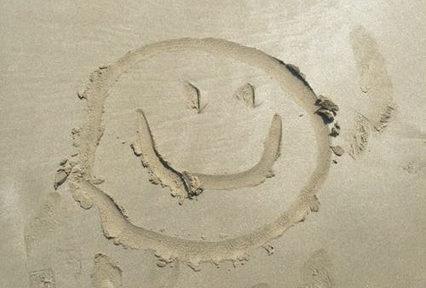
Just be you and be happy you are.
Every single one of you is a brilliantly unique person – embrace that!
If you were more like everyone else, you might think you would fit in better.
BUT there is no real normal, and everyone wishes they were more like someone else sometimes.

Slide 7
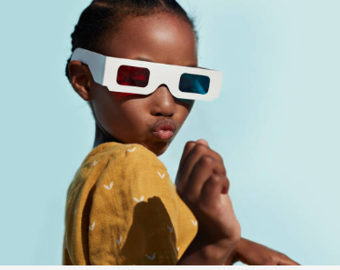
Try out who you are
Secondary school is a chance to find out who you are and discover your possible place in the world. You will get new opportunities to try things out and see what you can do.

Slide 8
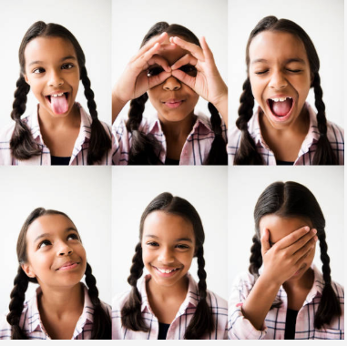
‘Find out who you are and do it on purpose’
Dolly Parton, American singer and songwriter

Slide 9
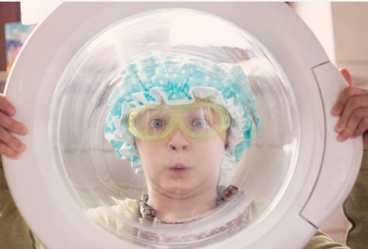
‘You are beautiful. It’s okay to be quirky, it’s fine to be shy. You don’t have to go with the crowd.’
Alek Wek, supermodel

Slide 10
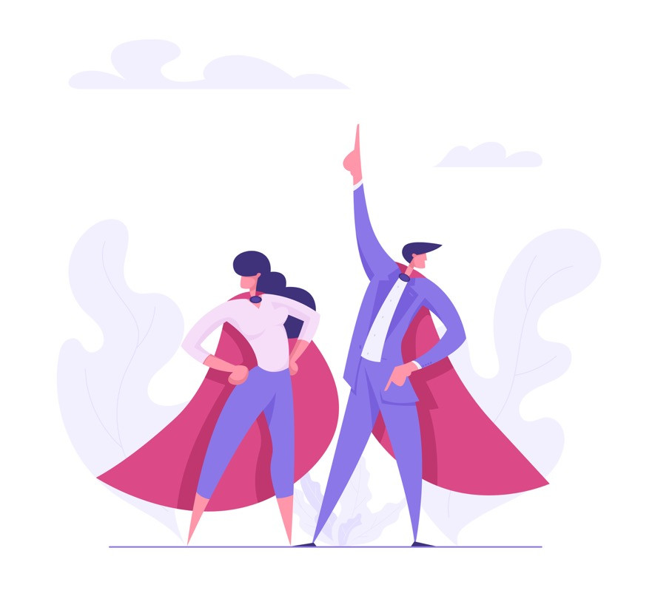
Transforming you into a superhero – your uniform

Slide 11
Some of the things that people often say when they get to secondary schools are:
‘Why do we have to wear this uniform?’
‘You say I am unique but don’t let me express it!’
‘What’s the big deal about uniform – why is it so strict? Does it even matter?’

Slide 12
What is the uniform you will have at your new school? Do some research: go onto the school website and have a look at what they say.
In your workbook:
Write down a list of things that you have to wear.
What are you NOT allowed to wear?
Your equipment is also part of your uniform. What do you have to take with you?

Slide 13
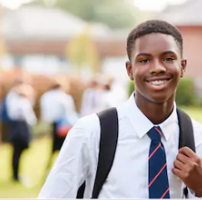
You should be proud to wear your uniform
Everyone in school is aiming for the same – and creating a sense of belonging is important.
This is why you have a uniform.
It is symbolic of your community.

Slide 14
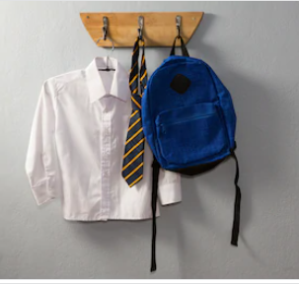
“Putting on a uniform every morning gets you in the zone and makes you part of a team. And, in the same way, a school uniform makes you switch into school mode. You’re part of a school, which is bound together by certain things….”
Rules, expectations, lessons, corridors, classrooms and, yes, you guessed it: UNIFORMS.

Slide 15
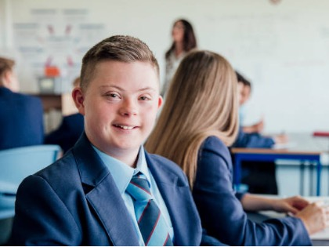
“Everyone is wearing the same badge. Everyone shares responsibility for each other and should feel that sense of responsibility.”
Matthew Burton

Slide 16
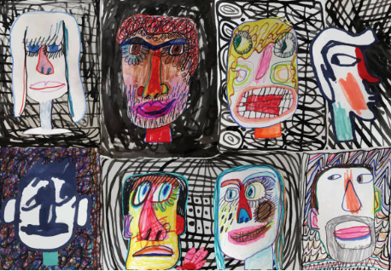
Find out who you are and do it deliberately
Activity:
Write down all of the ways you are different and unique.
How may these help you in your new school or in life?

Slide 17
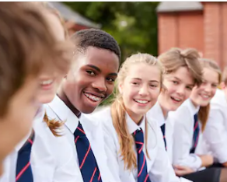
You belong to a new community
You can all have different personalities and have different opinions without wearing different clothes.
In uniform, we are:
Ready for work
Looking professional
Equal
Part of a community
Proud to be here
Important to our school
Not having to agonise over fashion statements!
We all look the same but express ourselves differently.

Slide 18
As far as uniform is concerned…
whatever the rule is: FOLLOW IT.

Slide 19
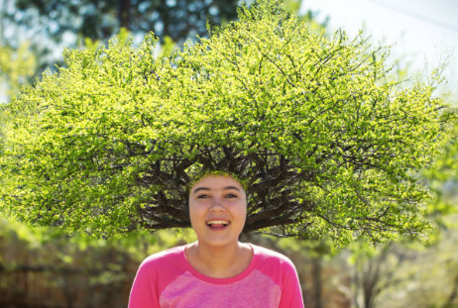
Live your life and don’t try to be someone else.

Slide 20
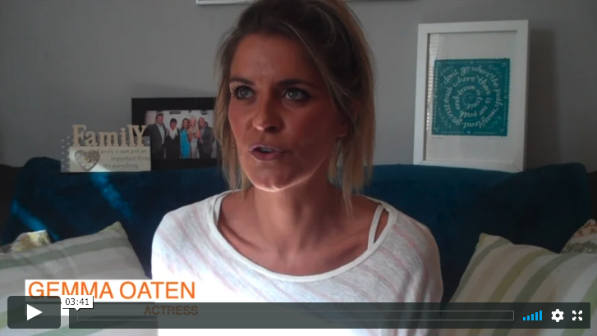
Here is Gemma, back again to end Session 7.

